Slide 1

Performance Measures
Matthew Engelhard
Notes:
Hi everybody
In this lecture, we’ll be learning about measures commonly used to assess classification performance
Having an in-depth understanding of these measures is critical when evaluating a model, whether it’s one you’ve developed or one you’re reading about in a scientific article
Throughout the course, we’ll be thinking about what these measures mean, mathematically, as well as their practical significance in a clinical or healthcare scenario

Slide 2
Goals
Understand and calculate common performance measures for binary classification
Contextualize performance against that of a no information classifier
Recognize that good performance depends on existing alternatives
Match clinical scenarios to performance measures important in that scenario
Notes:
By the end of the lecture, you should understand and be able to define and calculate the most commonly used performance measures for binary classification.
You should gain some intuition around what *good* performance is by considering the alternative – we’ll think about what we’d expect from a *bad* model – in other words, one whose predictions the outcome are no better than chance.
We’ll also talk about the fact that good performance is relative – it depends on alternative models or other approaches that might be available, and on how the model is intended to be used.
Lastly, we’ll start thinking about which performance measures are the best match for a given clinical scenario
There’s usually not a right or wrong answer here, so you’ll need to think about performance measures you believe make the most sense in each case, and why.

Slide 3
Back to cancer prediction. Suppose our features are highly informative. What might our model’s predictions look like?
?
Notes:
Let’s get started by going back to cancer prediction. We’ll suppose we have a model that is making predictions about patients’ cancer status, and we’d like to use those predictions to inform decisions about patient care.
We’ll begin by supposing the model has learned to make “good” predictions – in other words, predictions that are helpful in distinguishing between patients who do and don’t have cancer.
What will a useful model’s predictions look like?
We’ll with the *benign* cases. Would we hope that the predicted probabilities would be high, low, or somewhere in between? Pause here if you want to give it some thought.

Slide 4
Back to cancer prediction. Suppose our features are highly informative. What might our model’s predictions look like?
?
Notes:
For the benign cases, we’d hope the predicted probability of malignancy tends to be on the lower side. If we were to place a threshold on the predicted probability – say at 0.5 – to decide whether to perform an intervention or additional diagnostic test, the benign cases would tend to fall below the threshold.
Now, what about the malignant cases. Would we hope that the predicted probabilities would be high, low, or somewhere in between?

Slide 5
Back to cancer prediction. Suppose our features are highly informative. What might our model’s predictions look like?
Notes:
This time, we’d hope the predicted probability of malignancy is on the higher side. Compared to the benign cases, the malignant cases are more likely to fall above whatever decision-making threshold we might set.
Now, this is the situation we *hope* for – this is what *good*, informative predictions tend to look like.

Slide 6
below threshold: predict negative
above threshold: predict cancer positive
(NEGATIVES)
(POSITIVES)
Notes:
We can place a threshold on the predicted probability, and it tends to *separate* the negative cases from the positive ones.

Slide 7
below threshold: predict negative
above threshold: predict cancer positive
TRUE NEGATIVES
FALSE POSITIVES
(NEGATIVES)
FALSE NEGATIVES
TRUE POSITIVES
(POSITIVES)
Notes:
As we’ve discussed before, placing such a threshold divides our patient population into four groups.
When the model-predicted risk is below the threshold, we predict that that patient is negative – in this example, we predict they don’t have cancer
If we’re right, and they’re truly negative, that’s a true negative
If we’re wrong – they do have cancer – that’s a false negative
When the model-predicted risk is above the threshold, we predict that the patient is positive
If we’re right and they’re truly positive, that’s a true positive
If we’re wrong – they don’t have cancer – that’s a false positive
Once we’ve counted the number of patients in each group, we can calculate our four, threshold-specific performance measures.
The Sensitivity (aka recall, tpr), is the number of true positives divided by the number of positive cases, which is the true positives + false negatives
The Specificity (1-fpr), is the number of true negatives divided by the number of negative cases, which is the true negatives + false positives
The Positive predictive value (precision), is the number of cases above are threshold that are actually positive – in other words, the true positives divided by the true positives + false positives
And the Negative predictive value is the number of cases below the threshold that are actually negative
Back in the first lecture, we talked about which of these metrics depend on the prevalence. This is an important point, so if you aren’t sure, please go back to the first lecture and think through this point carefully.
But now we’re going to go a step further and think about how these values *change* as we move the threshold
ADDITIONAL NOTES
Metrics:
Sensitivity (recall, tpr)
Specificity (1-fpr)
Positive predictive value (precision)
Negative predictive value
Dependence on prevalence
Sensitivity: no (we draw more samples, but the TP/P ratio remains the same)
Specificity: no (we draw more samples, but the TN/N ratio remains the same)
PPV: yes (we draw more positive samples, and the TP/(TP+FP) ratio increases)
NPV: yes (we draw more positive samples, and the TN/(TN+FN) ratio decreases)

Slide 8
Receiver Operating Characteristic Curve
Illustrates the tradeoff between the true positive rate (i.e., sensitivity) and the false positive rate (i.e., 1– specificity) as we vary the threshold.
The area under this curve (AUC) provides a single summarizing this tradeoff.
Note that to get the sensitivity versus specificity curve, we simply rotate the ROC curve clockwise by 90 degrees. The areas under the two curves are the same.
Notes:
Let’s say we place our threshold at 0. Our model’s predictions will always be valid probabilities between 0 and 1, the range of the logistic, or sigmoid function – so if our threshold is at 0, the model’s predictions will always be above the threshold.
Since all patients are above the threshold, we correctly predict that all of the positive cases are positive, so our sensitivity is 1. However, we also incorrectly predict that all of the negative cases are positive, so our false positive rate is 1, and our specificity is 0. Thus, a threshold of 0 corresponds to the top right corner of the plot on the screen.
As we increase the threshold, each time we cross the model-predicted probability for a positive case, we’re no longer correctly identifying that case as positive, so the sensitivity goes down. However, each time we cross the model-predicted probability for a negative case, we start correctly identifying that case as negative, so the specificity goes up.
When our threshold gets all the way to 1, there are no cases above the threshold, so we’re predicting that all patients are negative. This gives us a sensitivity of 0 and a specificity of 1, which corresponds to the bottom left corner of the plot.
So, this curve – the receiver operating characteristic curve – it’s summarizing the tradeoff between sensitivity and specificity as we very the threshold. And the area under this curve (in other words, the AUC) – provides a single performance measure summarizing that tradeoff.
Points on this curve toward the top left – this is where we get both good sensitivity and good specificity. This may be a good point to consider what the predictions for positive and negative cases would need to look like for this plot to reach the top left corner – in other words, to achieve perfect sensitivity and perfect specificity at the same time, thereby achieving an AUC of 1.

Slide 9
So, what’s a good AUC value? (i.e., good performance)?
We’ll start to answer this question by taking a look at bad performance.
Notes:
At this point you might be wondering – so, what’s a *good* AUC value?
But we’re going to defer that question for a moment. Let’s start by thinking about what *bad* model performance would look like.

Slide 10
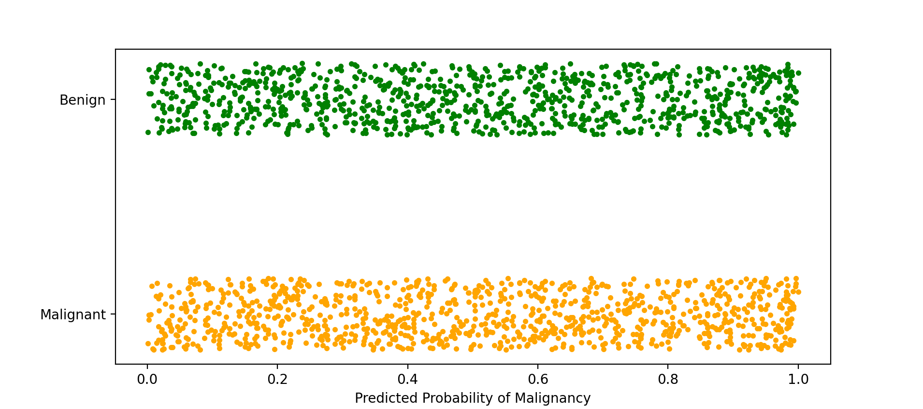
Suppose our features contain no information about the label. What might our model’s predictions look like?
?
Notes:
Let’s think about a model that’s learned nothing – its just making random predictions that aren’t even correlated with the true label. Let’s think about what those predictions might look like.

Slide 11
Suppose our features contain no information about the label. What might our model’s predictions look like?
Similar distributions between positive and negative cases.
The predicted value tells you nothing about which one it’s more likely to be.
Notes:
As before, we’ll use a raincloud plot to visualize model predictions for a population of patients, some of whom have cancer
This time the smoothed histogram would be a flat line, so I’ve omitted it.
For each patient, our no-good model just picks a number between 0 and 1 at random.
We see similar distributions between positive and negative cases, and in particular, the predicted value tells you nothing about whether how likely it is that that patient has cancer.

Slide 12
We’ll try placing a threshold just like before
below threshold: predict negative
above threshold: predict cancer positive
What is the:
Sensitivity?
Specificity?
Positive predictive value?
Notes:
Now, let’s go through the same process as before.
Again, we’ll place a threshold to guide our decision-making. If the model-predicted probability is below the threshold, we’ll predict the patient is negative, and if it’s above the threshold, we’ll predict the patient is positive and act accordingly.
For the threshold shown – let’s say it’s at 0.3 – what would the sensitivity, specificity, and positive predictive value be?
Pause here if you want to give it some thought.
Well, we’re correctly identifying the 70% of malignant cases that are above the threshold, so the sensitivity is 70%.
But we’re correctly identifying only the 30% of benign cases that are below the threshold, so the specificity is 30%.

Slide 13
We’ll try placing a threshold just like before
below threshold: predict negative
above threshold: predict cancer positive
What is the:
Sensitivity?
Specificity?
Positive predictive value?
Notes:
Let’s try another threshold, this time at 0.6.
What would the sensitivity, specificity, and positive predictive value be this time?
Again, pause here for a moment if you want to give it some thought.
This time we’re correctly identifying only the 40% of malignant cases that are above the threshold, so the sensitivity is 40%.
And we’re correctly identifying the 60% of benign cases that are below the threshold, so the specificity is 60%.

Slide 14
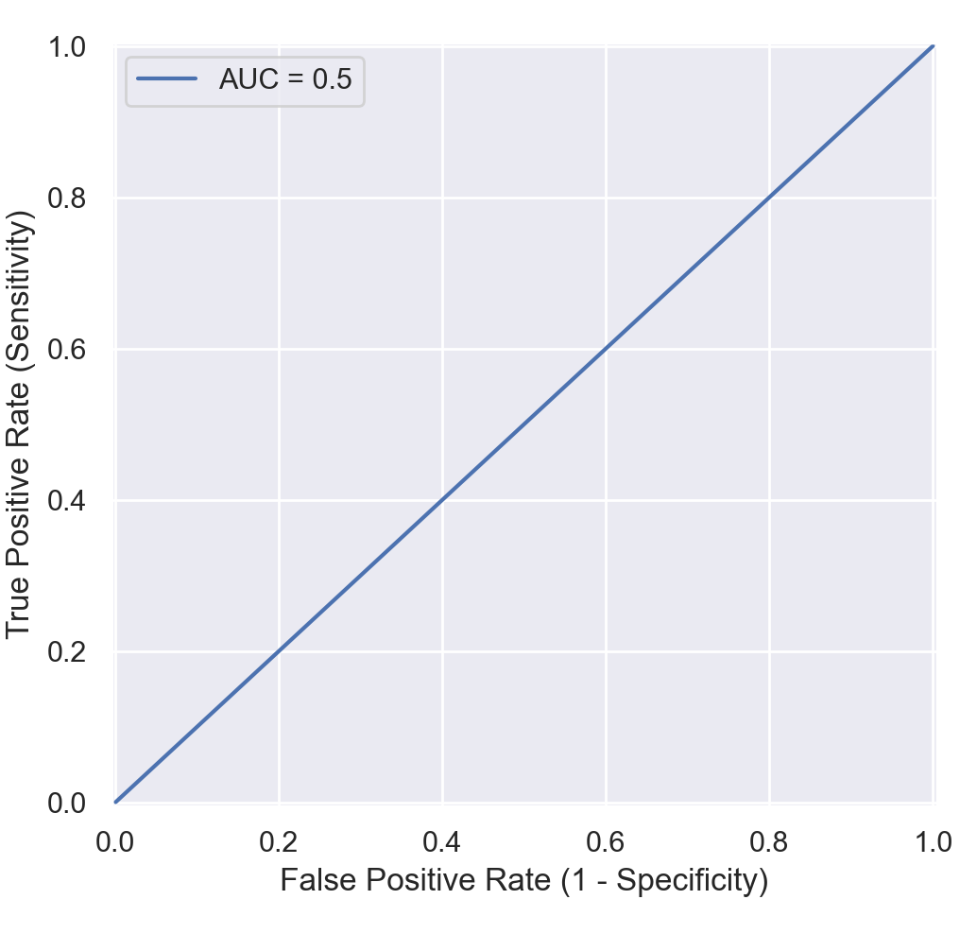
Our no information predictive model:
Place threshold at .3
Sensitivity = .7
False positive rate = .7
Specificity = 1-.7
Place threshold at p
Sensitivity = 1-p
False positive rate = 1-p
Specificity = p
Notes:
As the preceding diagram illustrates, when we place the threshold at probability p, we get a specificity of p and a sensitivity of 1 – p. So, when we plot sensitivity versus specificity for all possible thresholds between 0 and 1, we get the plot above. This figure is what the ROC curve looks like for a ‘no information’ classifier. And the area under this curve – the AUC – is 0.5.
Now, in the previous slides we were supposing predictions were uniform, but really, for *any* ‘no information’ classifier – in other words, any time the model’s predictions for positive and negative cases have the same distribution -- you’ll see this same relationship between the sensitivity and specificity.

Slide 15
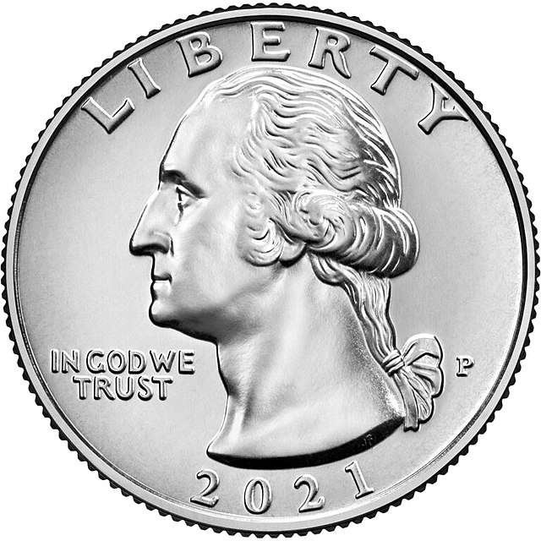
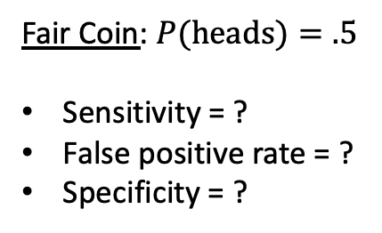
Let’s think about it a different way.
Suppose we have no predictors – again, no information – so we decide we’ll just flip a coin instead of building a model.
If the coin comes up heads, we’ll predict positive.
If the coin comes up tails, we’ll predict negative.
Fair Coin: $P(heads)=.5$
Sensitivity = ?
False positive rate = ?
Specificity = ?
Notes:
We can make this even simpler by forgetting about the distribution of model-predicted probabilities.
Let’s suppose we have no predictors – in other words, no information to use to make an informed guess as to the outcome – and so instead, we just flip a coin to make our prediction.
If the coin comes up heads, we’ll predict that the patient has cancer.
And if the coin comes up tails, we’ll predict that they don’t.
Suppose we have a fair coin – in other words, it comes up heads 50% of the time and tails 50% of the time.
What are the sensitivity and specificity for this classifier?
Pause for a moment if you’d like to give it some thought.

Slide 16
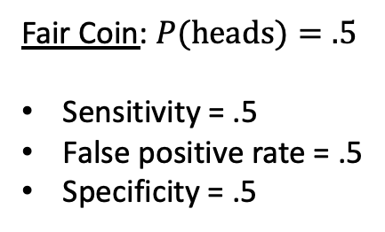
Let’s think about it a different way.
Suppose we have no predictors – again, no information – so we decide we’ll just flip a coin instead of building a model.
If the coin comes up heads, we’ll predict positive.
If the coin comes up tails, we’ll predict negative.
Fair Coin: $P(heads)=.5$
Sensitivity = .5
False positive rate = .5
Specificity = .5
Notes:
Well, for each of the positive cases, we’re 50% likely to predict positive, so our sensitivity is 50%.
And for each of the negative cases, we’re 50% likely to predict negative, so our specificity is 50%.
As a challenge, consider what the positive predictive value would be for this classifier. Note that you’ll need to answer in terms of the prevalence, also called the base rate, of positive cases in your sample.

Slide 17


Let’s think about it a different way.
Suppose we have no predictors – again, no information – so we decide we’ll just flip a coin instead of building a model.
If the coin comes up heads, we’ll predict positive.
If the coin comes up tails, we’ll predict negative.
Fair Coin: $P(heads)=.5$
Sensitivity = .5
False positive rate = .5
Specificity = .5
Biased Coin: $P(heads)=p$
Sensitivity = ?
False positive rate = ?
Specificity = ?
Notes:
Now let’s consider the more general case, where our coin is biased so that it doesn’t necessarily come up heads and tails at equal rates.
Let’s suppose it comes up heads with probability p.
What’s the sensitivity and specificity for our coin-based, no information classifier?
Pause here for a moment if you’d like to give it some thought.

Slide 18

Let’s think about it a different way.
Suppose we have no predictors – again, no information – so we decide we’ll just flip a coin instead of building a model.
If the coin comes up heads, we’ll predict positive.
If the coin comes up tails, we’ll predict negative.
Fair Coin: $P(heads)=.5$
Sensitivity = .5
False positive rate = .5
Specificity = .5
Biased Coin: $P(heads)=p$
Sensitivity = 1-p
False positive rate = 1-p
Specificity = p
Notes:
Well, for each of the positive cases, the chance we make a positive prediction is 1-p, so our sensitivity is 1-p.
And for each of the negative cases, the chance we make a negative prediction is p, so our specificity is p
And the false positive rate, which is always 1 minus the specificity, is 1-p, because we predict that 1-p of the negative cases are positive.

Slide 19
Again, we arrive at the following no information curve
We may choose any p between 0 and 1 to get:
Sensitivity = p
False positive rate = p
Specificity = 1-p
What’s the area under this curve (AUC)? --> 0.5
Notes:
Again, we arrive at our no information curve, where we can vary the threshold from 0 to 1 and always get both sensitivity and false positive rate equal to 1 minus the threshold.
And again, the area under this curve is 0.5.
So, now we’ve seen what BAD performance looks like – namely, a diagonal line running from bottom left to top right on the ROC curve, and a corresponding AUC of 0.5.

Slide 20
So, what’s a good AUC value? (i.e., good performance)?
It depends.
Are predictions better than random?
Are predictions than the previous best performing model?
Are predictions better than expert performance?
Does performance exceed our (informed) expectations?
Is the model clinically useful?
Notes:
But what’s *good* performance look like.
Well, you might be tempted to apply some rule of thumb. Often people say that an AUC of 0.7 – or something in that ballpark – is *good* performance.
But the truth is that it depends.
An AUC of 0.90 when predicting whether an image contains a dog would be poor in 2022, but in 2010, it would have been unprecedented.
And an AUC of 0.90 would be outstanding – likely even too good to be true.
In some cases, we might be happy knowing that our predictions are better than random.
In other cases, there’s an existing approach that we’re competing against, and so we’re looking to exceed its performance
Often it makes sense to pit the model against human experts – we’ll see this in some of our readings in the clinical literature
Importantly, we can apply statistical hypothesis tests to compare performance. To compare two ROC curves, you can use a Delong test, named for the former chair of biostats at Duke, and to compare sensitivity or specificity, you can use a two-sample proportion test.
Again, the critical point here is that *good* performance is different depending on the context, and depends on your objectives as well as what alternative approaches are available.

Slide 21
OK, we’ve quantified performance across all thresholds. But how do we use the model?
Sometimes the predicted probability really is what we care about.
Example: probability of heart attack
If so, we need to make sure our model is calibrated
More often, we need to pick a threshold so we can decide whether to:
Alert a provider
Get a biopsy
Refer the patient
etc
What threshold should we pick? What’s the right tradeoff?
Notes:
Now as we’ve discussed, we like to be agnostic to the particular decision threshold when quantifying model performance.
However, to actually use predictive models in decision-making, we typically need to pick a specific threshold
Our choice reflects the relative cost we place on false positives versus false negatives – in other words, how much we’re worried about missing cancer versus performing unnecessary testing or interventions.
And of course, this will depend on the scenario. Let’s run through a few hypotheticals.

Slide 22
Healthcare Scenarios Which performance measure is most important?
A computer vision model that detects carcinoma
Notes:
Suppose you were specifying a decision threshold for a computer vision model that detects carcinoma.
Would you be more worried about missing cancer, and therefore pick a high sensitivity threshold, or would you be more worried about unnecessary tests or intervention, and therefore pick a high specificity threshold?
There’s no right answer here – in reality, you’d need to understand the clinical scenario in much more detail to make this call.

Slide 23
Operating Point: high sensitivity
Notes:
Supposing you were more worried about missing cancer, you might pick a high sensitivity operating point like the one shown here.

Slide 24
Healthcare Scenarios
A computer vision model that detects carcinoma
An algorithm that detects atrial fibrillation in Apple Watch users
Notes:
Now suppose you were specifying a decision threshold for an algorithm that detects atrial fibrillation in Apple Watch users.
Apple is understandably very concerned about raising too many false alarms given the large number of individuals that wear an Apple watch, therefore they are likely to pick a high specificity threshold…

Slide 25
Operating Point: high specificity
Notes:
…which might look something like this.

Slide 26
Healthcare Scenarios
A computer vision model that detects carcinoma
An algorithm that detects atrial fibrillation in Apple Watch users
An EHR-based model that monitors autism risk
Notes:
In my research, I consider EHR-based predictive models that monitor autism risk from a young age.
We are trying to identify as many children as possible as early as possible, but at the same time, there’s already a long waiting list to see a specialist, and if we create too many false alarms, we’re going to overburden the system and end up delaying diagnosis for *everyone*.
Therefore we may end up choosing a “balanced” operating point that prioritizes specificity and sensitivity about equally.

Slide 27
Operating Point: balanced
Notes:
Here’s an example of what that might look like.

Slide 28
Healthcare Scenarios
A computer vision model that detects carcinoma
An algorithm that detects atrial fibrillation in Apple Watch users
An EHR-based model that monitors autism risk
Sometimes specificity and sensitivity are difficult to interpret, particularly for rare conditions or events.
The most clinically relevant measure is often the positive predictive value (or negative predictive value).
Notes:
Now, particularly for rare events, it often makes most sense to focus on positive or negative predictive value rather than sensitivity or specificity.
The PPV and NPV are often more directly relevant to decision-making, because they tell us what we can expect in terms of the true outcome after seeing a positive or negative result, respectively.
And we also know that for rare events, PPV can be low even when specificity is relatively high, because there are many more negative cases than positives.

Slide 29
The Precision-Recall Curve (i.e., PPV-Sensitivity Curve)
Often has greater direct clinical relevance than the ROC curve
The no information classifier always achieves PPV equal to the base rate, or prevalence (why?)
PPV as well as the area under this curve (average precision) must be interpreted relative to prevalence
Notes:
As an important complement to the ROC curve, therefore, we often also want to plot a precision-recall curve – in other words, a sensitivity versus PPV curve.
The principles are very similar to the ROC curve. If we place our threshold near 1, we catch very few cases, therefore our sensitivity is near 0; however, our PPV is high.
On the other hand, if we place our threshold near 0, we’re predicting that every case is positive, therefore our positive predictive value – in other words, the rate at which we observe positive cases among our predicted positive cases -- is equal to the prevalence.

Slide 30
Operating Point: high sensitivity
Notes:
Here we can see our high sensitivity operating point on the precision-recall curve.

Slide 31
Operating Point: high specificity
Notes:
Here’s our high specificitiy operating point on the precision-recall curve.

Slide 32
Operating Point: balanced
Notes:
And finally, here’s our balanced operating point. Please take a moment to think carefully about these curves and the relationships between them.

Slide 33
Summary
It is critical to understand performance measures in order to critically evaluate models and put them to clinical/healthcare use.
To contextualize performance, we often compare models to a no information model whose predictions are random.
However, good performance depends on existing alternative approaches, both tech- and non-tech-based, and the clinical scenario.
Which measure is most important also depends on the clinical scenario.

Slide 34
Supplementary Content

Slide 35
Multi-class problems: “Confusion Matrix”
Predicted Label
Correct Prediction
True Label
Incorrect Prediction
Notes:
Now, in everything we’ve discussed so far, we’re thinking about binary problems – we’re distinguishing positive cases from negative cases
But in this course, we’ll also be considering multi-class problems, in which we’re predicting which of several labels corresponds to our patient, or case
For example, we might predict that a skin lesion is cancerous or benign – this is binary – but alternatively, we might predict what kind of lesion it is – a carcinoma, actinic keratosis, melanoma, and so on
In these problems, instead of a 2 by 2 ”confusion matrix” of TPs, FPs, TNs, and FNs, we instead have an N x N matrix, where N is the number of classes. We can think of this as a cross-tabulation between the true labels and predicted labels. In the top left corner, we have a count of cases for which the true label was the first label –and the predicted label was also the first label. Along the same lines, the box in the 2nd row, 3rd column tells us how many cases there were where the true label was the second label, but our model predicted the third label.
One metric we can calculate directly from this matrix is the accuracy – this is simply the number of correct predictions over the number of total predictions – in other words, the sum of the blue boxes divided by the sum of all boxes
However, it’s not obvious how all the metrics we’ve discussed previously, which are quite useful, can be applied here.

Slide 36
Multi-class problems: Binary for Label 1
Predicted Label
TruePos
<---- False Negatives ---->
False Pos
Correct Prediction
True Label
True Negatives
Incorrect Prediction
<---- False Positives ---->
Notes:
One approach – really the only approach that is common – is to instead go back to binary prediction for each of the labels of interest.
We can consider only the first label, for example. Each patient, or case, is labeled either with that label, or with some other label; and similarly, the model either predicts that label, or it predicts some other label.
If the true label is the first label, and the model also predicts the first label, that’s a true positive; whereas if the model predicts a different label, that’s a false negative.
And if the true label isn’t the first label, and the model predicts the first label, that’s a false positive; whereas if the model predicts a different label, that’s a true negative.
We can then look at all our earlier metrics – sensitivity, specificity, etc – with respect to the binary prediction task defined by the first label.

Slide 37
Multi-class problems: Binary for Label 2
Predicted Label
True Negatives
TruePos
<---- -------- False Negatives ---->
Correct Prediction
True Label
<---- True Negatives --------- ---->
<---- False Positives --------- ---->
Incorrect Prediction
True Negatives
Notes:
And, in exactly the same way, we can define all these metrics with respect to any of the other labels.
Sometimes, we might even consider the average of these metrics across all these binary tasks – a mean precision, for example, not to be confused with the average precision, which is an approximation to the area under the precision-recall curve.

Slide 38
Model Calibration
A very brief overview
Notes:
Lastly, let's think about a different way of evaluating model predictions. Rather than focusing on how well the model distinguishes between positive and negative cases, we can think about whether the model's predictions are an accurate reflection of the true probability of the positive outcome.

Slide 39
below threshold: predict negative
above threshold: predict cancer positive
(NEGATIVES)
(POSITIVES)
Notes:
Last time we considered this problem, we said that our goal was to find a best rule for predicting whether cancer is present based on these values
Said another way, we’re interested in discriminating positive and negative cases, and we want to find a good threshold for doing so
This is what we ought to care about if we’re using our model to make a binary decision – maybe we’re going to treat one group and not the other, or we’d like to decide whether to schedule additional diagnostic testing
And to do this well, it doesn’t really matter whether our predicted probabilities are accurate
All that matters is whether the values tend to be higher for positive cases than for negative ones. As long as that’s true, the values allow us to discriminate between groups effectively
However, there are other cases in which we do care about the actual values that have been predicted rather than just their relative order
Let’s suppose we were going to order a biopsy based on this prediction, and we wanted to calibrate the patient’s expectations by telling them how likely it is that the biopsy will come back positive
In this case, if we tell them the risk is 45%, we’d like to be confident that given the information available so far, there really is about a 45% chance that the biopsy will come back positive
Said another way, in this case we care about is whether our predicted probability is a good estimate of true risk – this is called model calibration

Slide 40
Assess Calibration Graphically
Q1 Q2 Q3 Q4 Q5
(NEGATIVES)
(POSITIVES)
Notes:
There are a number of measures used to assess calibration
All of them involve looking at the difference between model-predicted probabilities and estimate of true risk
We’re going to focus less on calibration in this course, but we’ll consider a simple, graphical approach that is the basis for several commonly used calibration metrics
First, we’ll divide model-predicted risk into quintiles
This could also be deciles, for example, but we’ll stick to a small number of groups here to keep things simple
In each quintile, we can calculate what proportion of patients ended up with a positive biopsy.
In a calibrated model, this proportion should be similar to the average model-predicted risk in that quintile

Slide 41
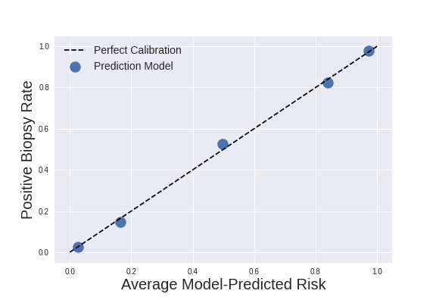
Assess Calibration Graphically
Notes:
If we do that for each quintile, we get a scatter plot that tells us how well model-predicted probabilities agrees with true event probabilities in each quintile
In a perfectly calibrated model, these values should match
This model is very close to perfect calibration
If we wanted to put a number on calibration, we might look at the slope and intercept of a best fit line connecting these points
Or we might use a test statistic based on these values
But in many cases, a graphical approach will suffice

Slide 42
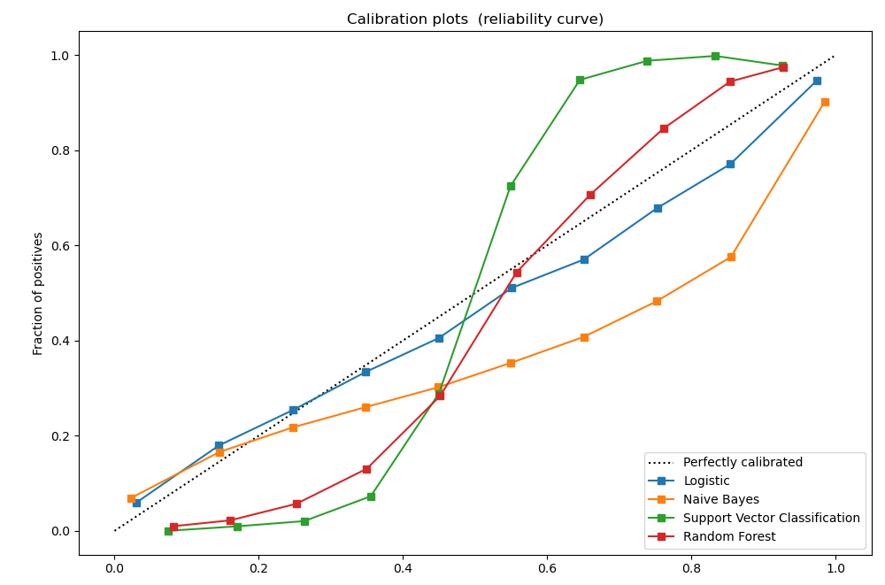
Assess Calibration Graphically
Model-Predicted Risk
From: https://scikit-learn.org/stable/modules/calibration.html
Notes:
Just to give you a sense of what a more typical calibration plot might look like, here’s an example from the scikit-learn documentation

Slide 43
There are many more, of course, but classification metrics go a long way.
Regression
Mean squared error (MSE)
Mean absolute error (MAE)
R²
Survival Analysis (i.e. failure time)
Concordance index
MSE, MAE
Brier Score
AUC_{t}
Notes:
Of course, other kinds of models have different associated metrics. In regression tasks, we’re often interested in the mean squared error or mean absolute error, for example.
But in this class, we’ll be limiting ourselves to the performance metrics we’ve already discussed.
Please make sure you understand them! Again, this is critical not only to developing models, but also to using them appropriately in clinical practice and other healthcare applications.

